Slide 3
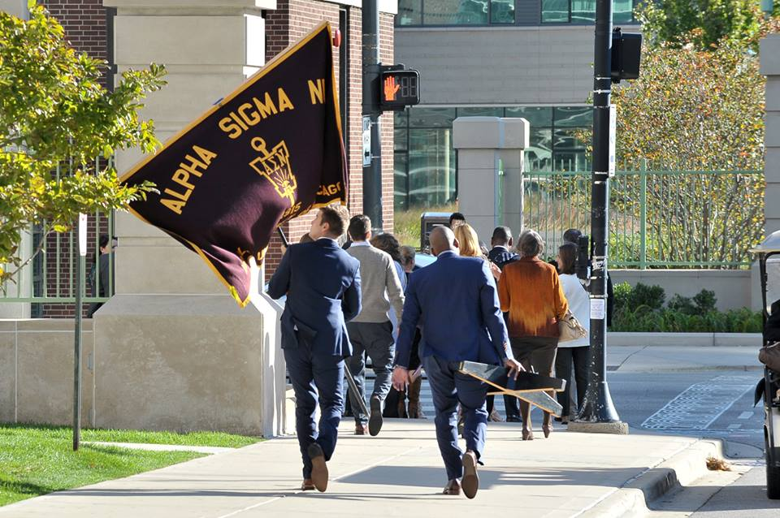

Slide 4
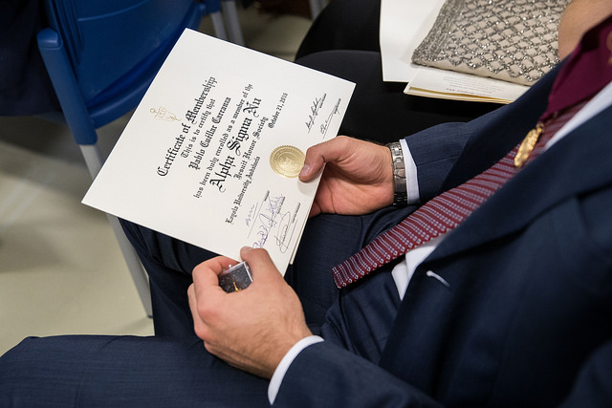

Slide 5
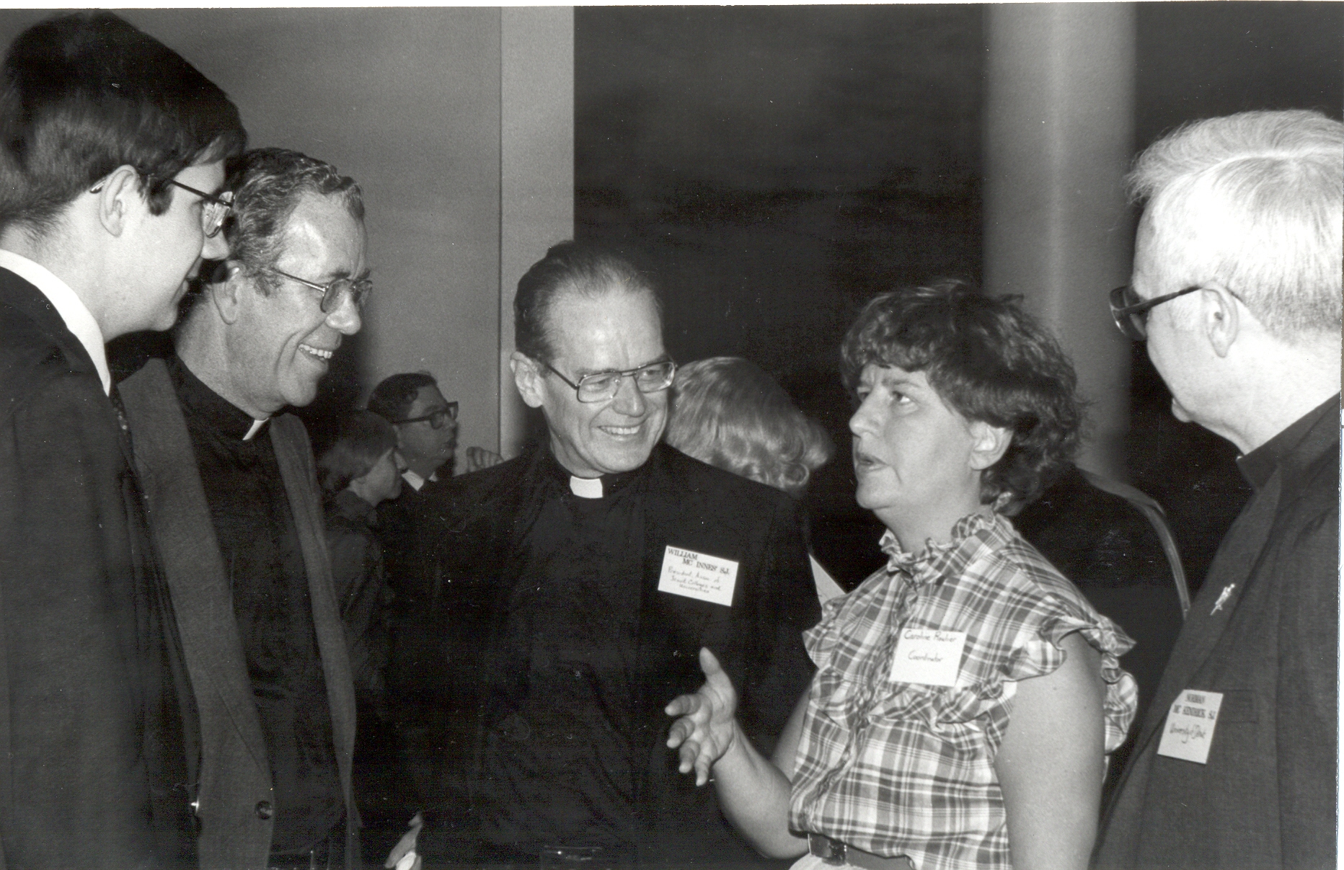

Slide 6
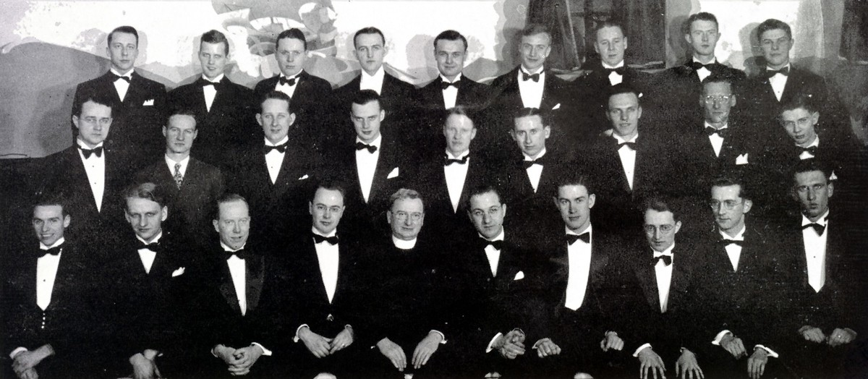
https://www.alphasigmanu.org/about/history/

Slide 7
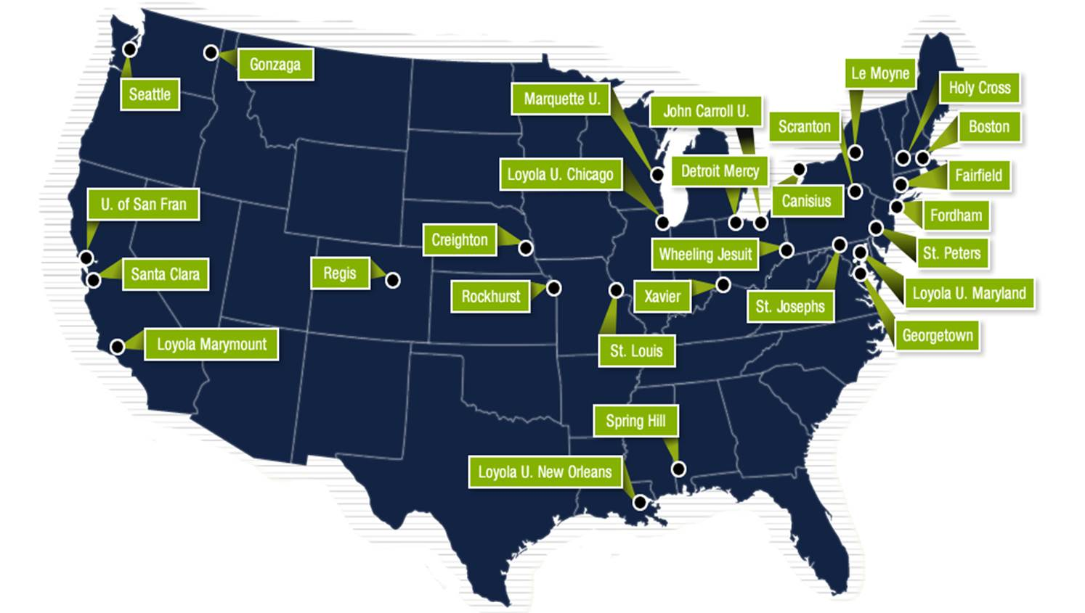

Slide 8
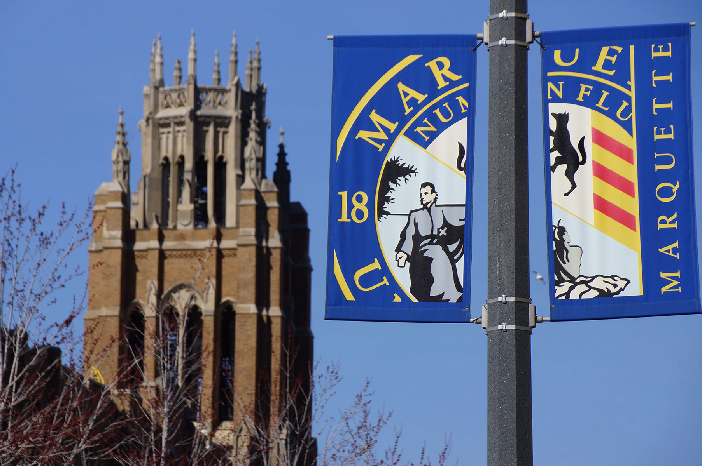

Slide 9
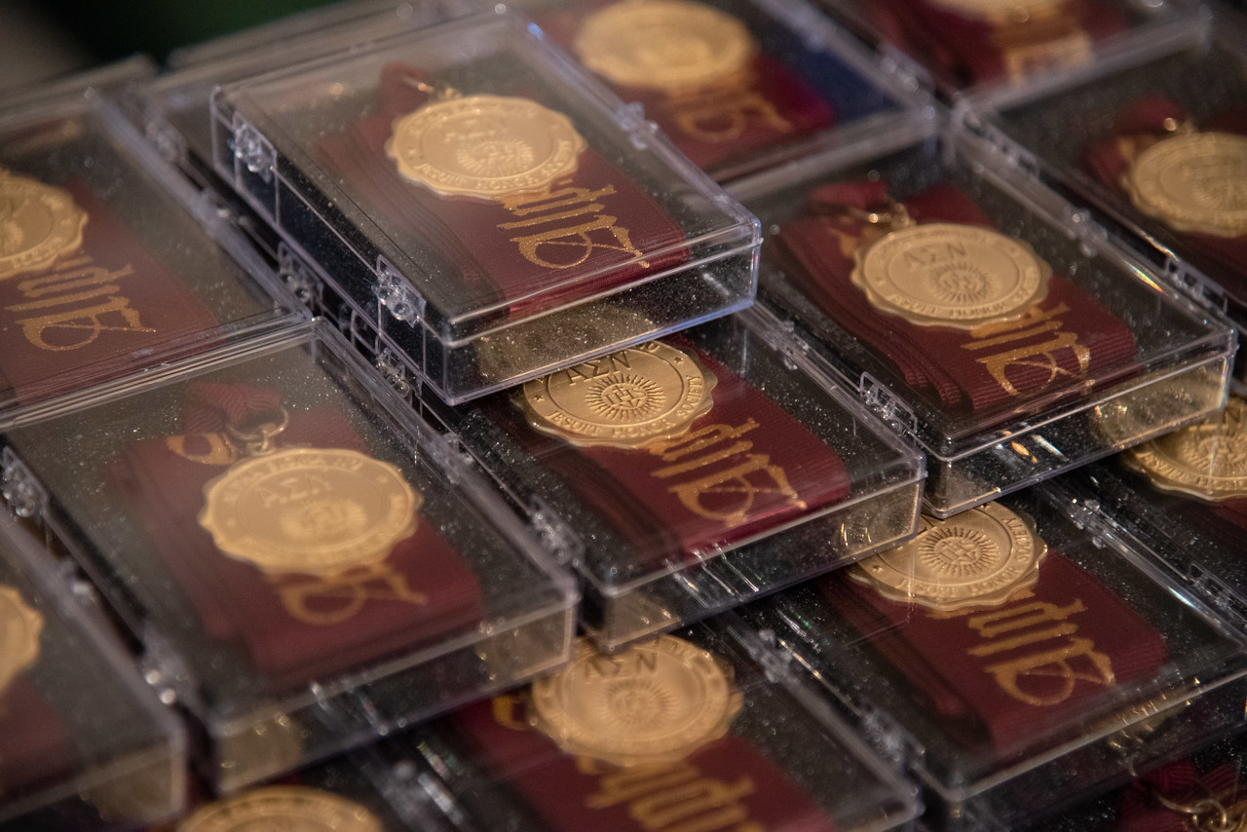

Slide 10
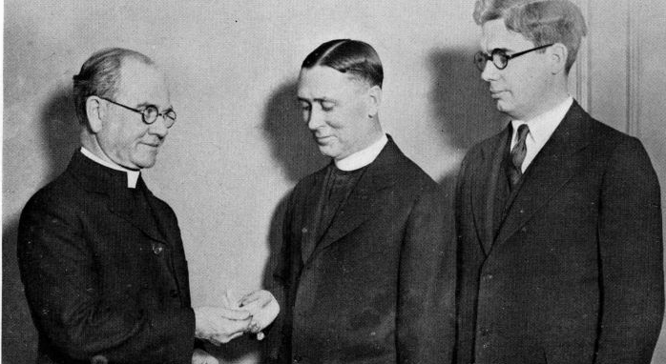

Slide 11
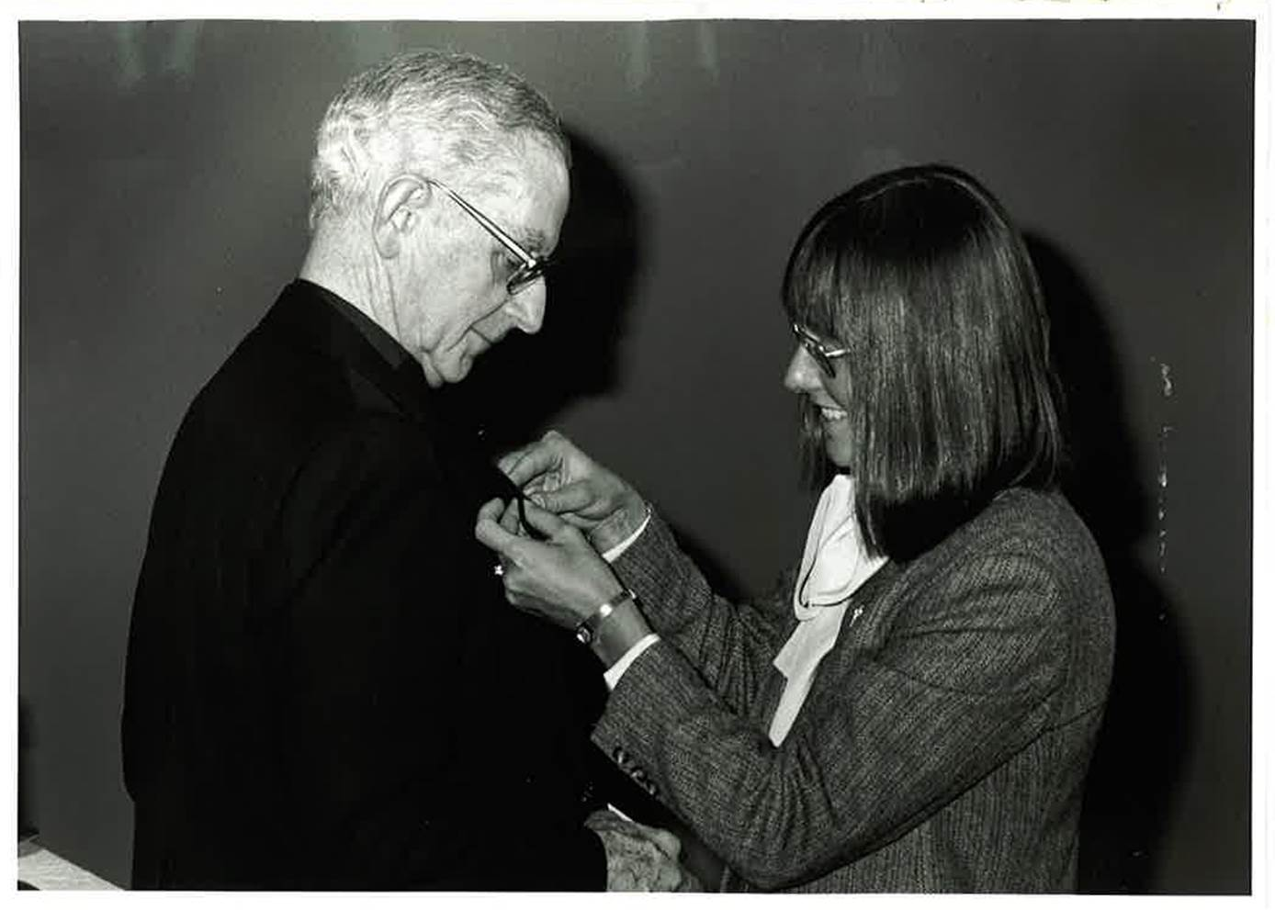

Slide 12
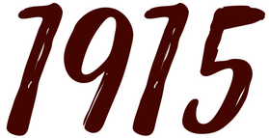

Slide 13
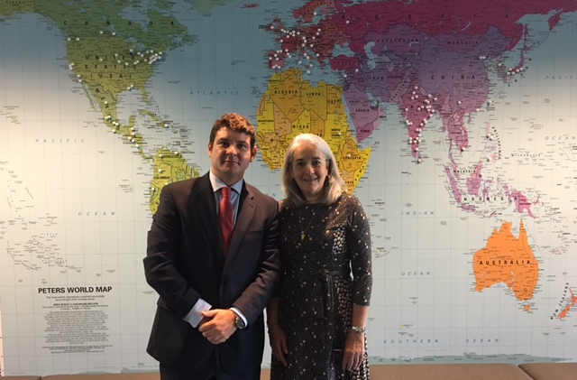

Slide 15
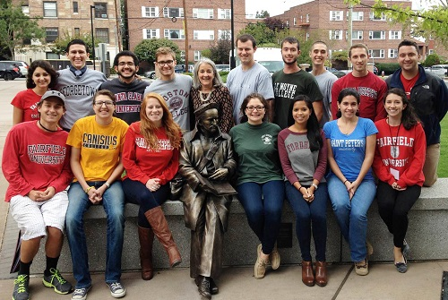

Slide 16
Boston College
Campion College
Canisius College
College of the Holy Cross
Creighton University
Fairfield University
Fordham University
Georgetown University
Gonzaga University
John Carroll University
Le Moyne College
Loyola Marymount University
Loyola University Andalucia
Loyola University Chicago
Loyola University Maryland
Loyola University New Orleans
Marquette University
Regis College
Regis University
Rockhurst University
Saint Joseph’s University
Saint Louis University
Saint Peter’s University
Santa Clara University
Seattle University
Sogang University
Spring Hill College
Universidad del Pacifico
University of Detroit Mercy
University of San Francisco
University of Scranton
Xavier University

Slide 17
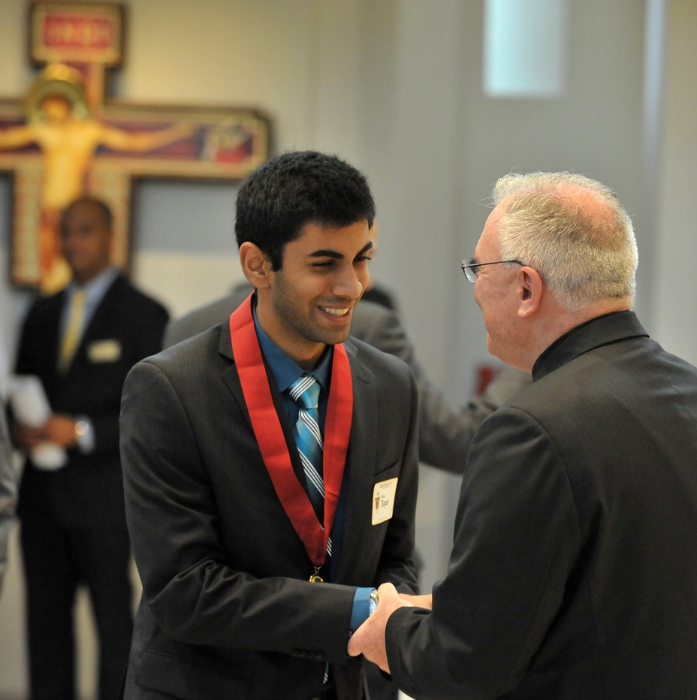

Slide 18
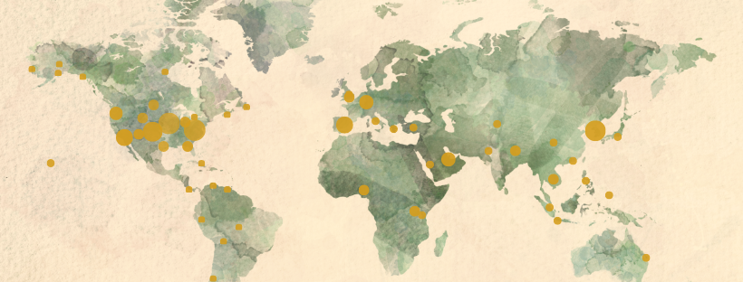

Slide 19
alphasigmanu.org

