Slide 1
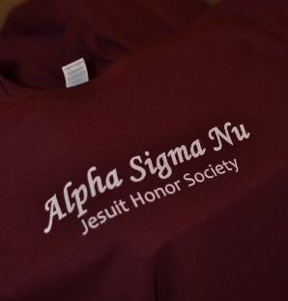
ADVISER + Coordinator
BASICS

Slide 2
Alpha sigma who?
The only honor society permitted to bear the name Jesuit!
Mission:
Alpha sigma nu, the honor society of Jesuit institutions of higher education, recognizes those students who distinguish themselves in scholarship, loyalty and service. The only honor society permitted to bear the name Jesuit, ΑΣΝ encourages its members to a lifetime pursuit of intellectual development, deepening Ignatian spirituality, service to others, and a commitment to the core principles of Jesuit education.
Vision:
Alpha sigma nu: A dynamic society whose members, honored as students for embodying scholarship, service, and loyalty to the ideals of Jesuit education, embrace Ignatian values as guides and challenges to be collaborators in the Jesuit mission.
SCHOLARSHIP LOYALTY SERVICE

Slide 3
ADVISER JOB DESCRIPTION
Being the guide, spirit, and face of AΣN for Chapter leaders and the wider campus
Ensuring a quality membership experience for each student member – future connection to the society depends on the student member experience
Being responsible for the AΣN image on campus
Communicating the Society's ideals to each new generation of students
Serving as the historical continuity of the Chapter given annual turnover
Chapter officers should assume the responsibility of conducting the Chapter's affairs; still, the Adviser is critical.
Faculty Advisers:
Establish a noteworthy presence on campus to attract strong candidates. Membership in AΣN is the most prestigious honor a Jesuit institution can award, and all qualified students should be aware of their eligibility.
Provide instruction and inspiration for the local Chapter and guide the student members in managing the local Chapter.
Because Chapter officers change every year, the Faculty Adviser will need to be sensitive to the leadership potential of each group of officers and compensate for occasional lapses.
Direct the students in the screening and selection of new members.
Submit induction forms for new inductees to the Central Office.
Oversee the planning of the induction ceremony.
Encourage AΣN alumni participation in Chapter activities.
Complete annual Faculty Adviser Report and New Leadership Report by the end of the academic year.
Encourage presidents to participate on the presidents’ conference calls and submit the Chapter of the Year application by the deadline.

Slide 4
resources
We’re here to help

Slide 5
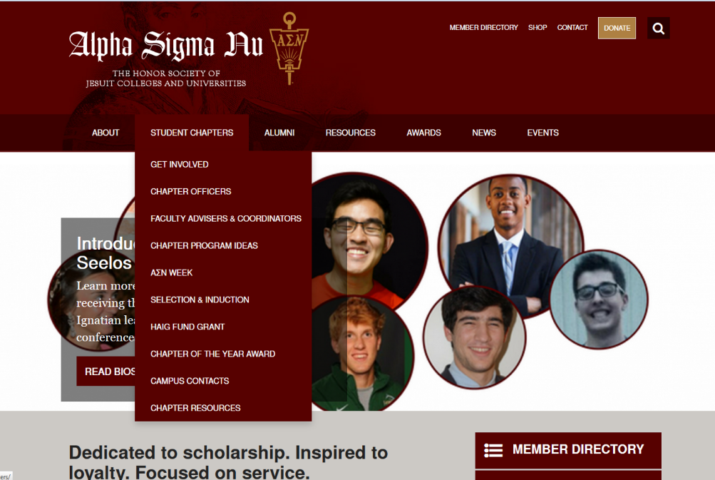
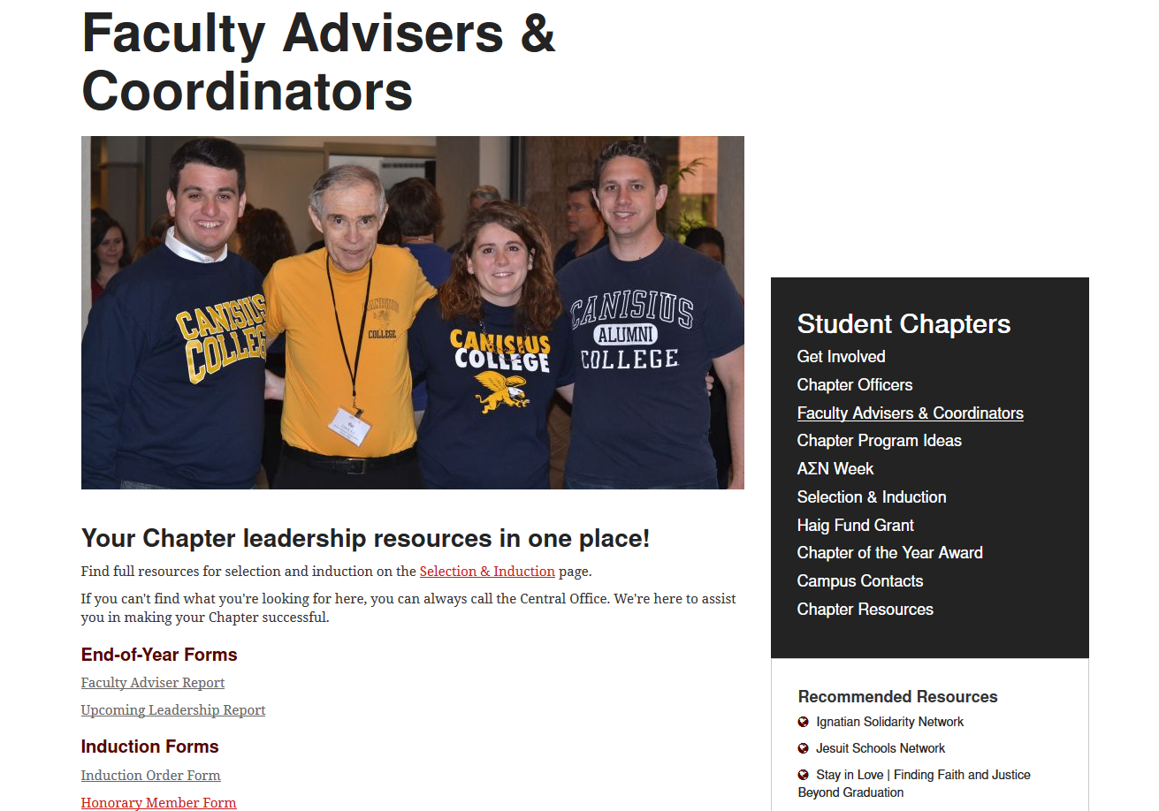
Website www.alphasigmanu.org
Adviser + Coordinator Hub!
News + Events
Social Media links
Induction Ideas
Programming Ideas and Templates
Seelos Grant information
Online Member Directory
Password: JESUIT
Campus Contacts!!

Slide 6
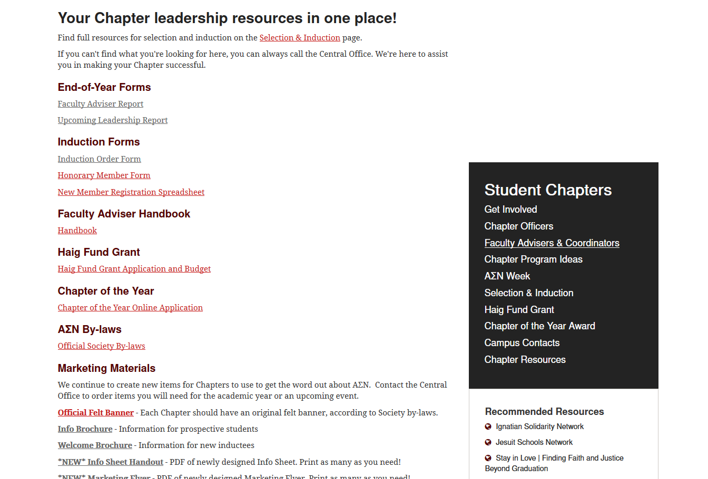
Website Advisers + Coordinators Page
Forms
Handbook
Idea Books
Induction Resources
Chapter of the Year
Contact list
Marketing downloads + resources
Official logos and insignia
Grant Info

Slide 7
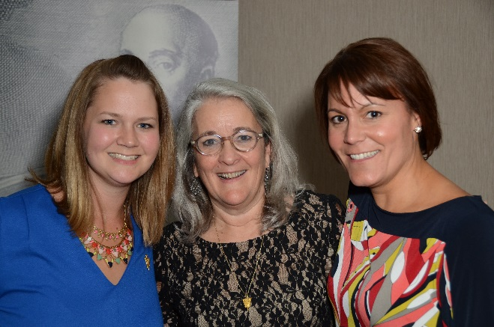
More Resources
The Central Office – we’re always a call or email away
Faculty Adviser Handbook
Printed Materials – Brochures, tents, covers, table runners, postcards, info posters, etc.
Pull-up Banners
Official felt banner
Kristina, Kate, + Amy

Slide 8
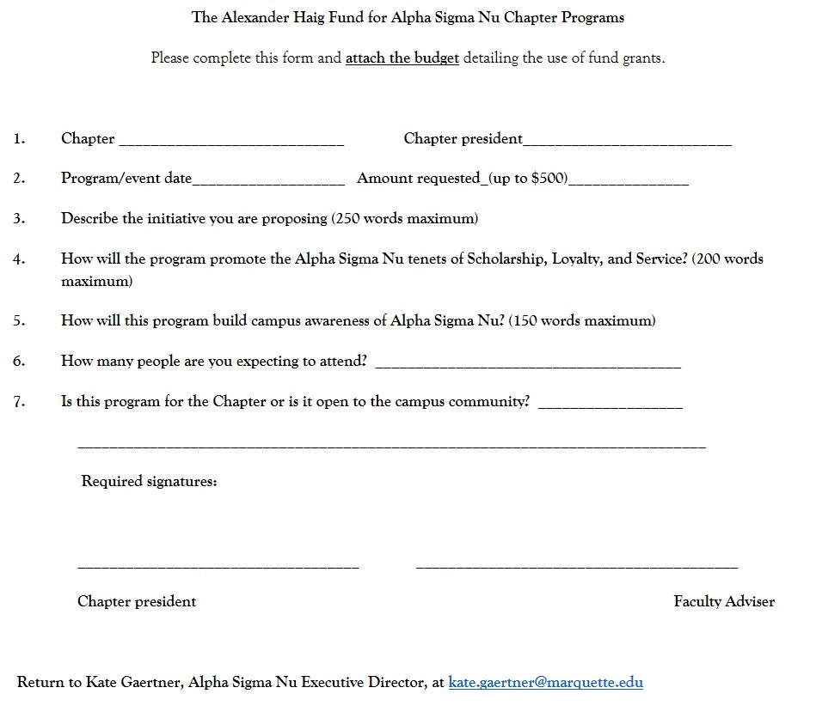
Haig Fund Grants
Grants up to $500 for Chapter programming
Application on the Student Chapters page
Fill out and submit with signatures
Board of Directors votes on grant approval
Generally a quick turnaround on approval
Encourage students to think big(ger) by reminding of the grants

Slide 9
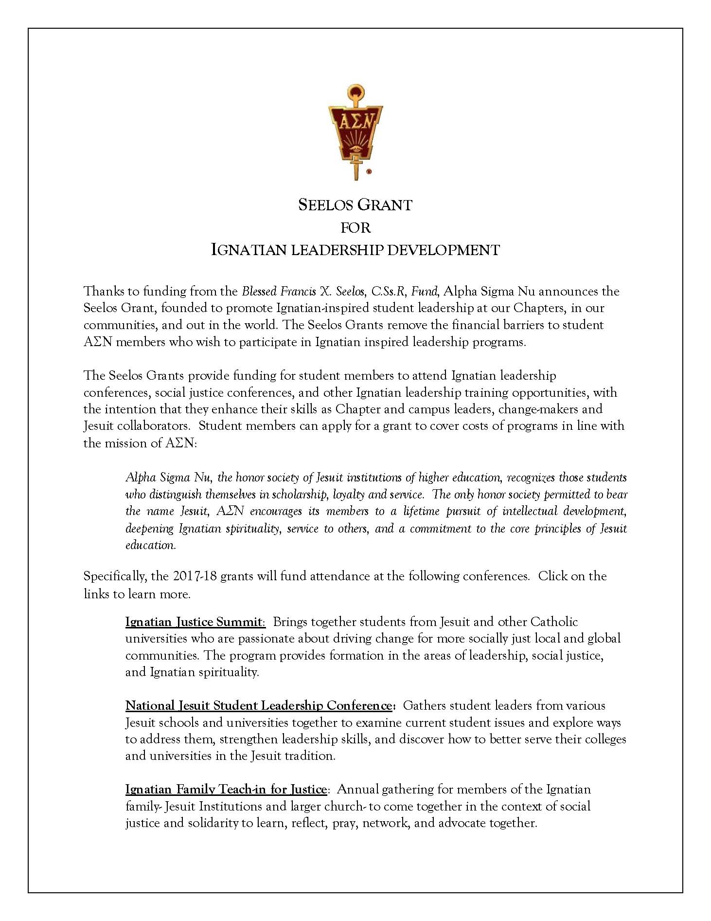
Seelos Grant
Grants for current student members
Fund attendance at Ignatian justice and leadership conferences
To train Ignatian-inspired leaders for our Chapters and our world
Application on the website and to be emailed to all current student members
Conferences/events will be updated
Your role: Encourage students to take advantage of the opportunity!

Slide 10
Chapter of the YeaR
Online form – Student Chapters page
Chapter President to fill out and submit
MANDATORY!! Replaces the Chapter Secretary Report
Deadline April 15th – to ensure we can award before end of school year
Use as a roadmap of ASN projects for the academic year
Emphasis is given to quality over quantity – how well does the Chapter exemplify the ASN tenets in its programming?
Plaque and $500 check awarded to winning school at a school-run event – Kate to attend

Slide 11
Induction
Everyone’s favorite time of year

Slide 12
INDUCTION
Handbook timeline as guide (pages 17-18)
Central Office Deadline
Forms due SIX weeks prior to the induction date
Vendors require this lead time to ensure materials can be customized and shipped in time for your induction
Any necessary expedited shipping due to late orders will be charged to the Chapter
What must be received by deadline?
{EMAILED} Signed and completed Induction Order Form, Honorary Member Forms, and completed New Member Registration Spreadsheet
Replacements/errors
Certificate $15, Pin/Pendant $25

Slide 13
Induction Cont…
The hardcopy forms should be mailed with the check (or separately, if check ships from Accounts Payable)
Should arrive BEFORE your induction date!

Slide 14
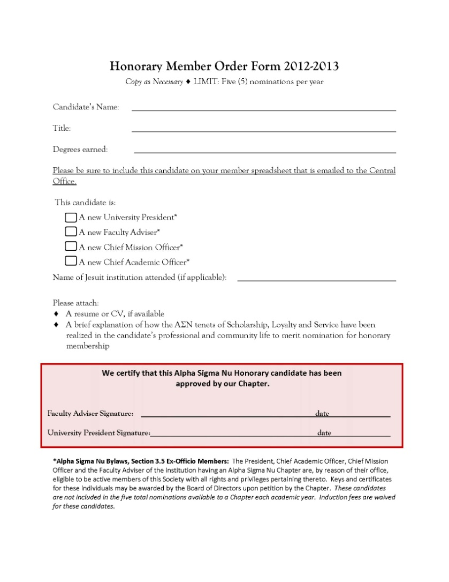
Induction Forms

Slide 15
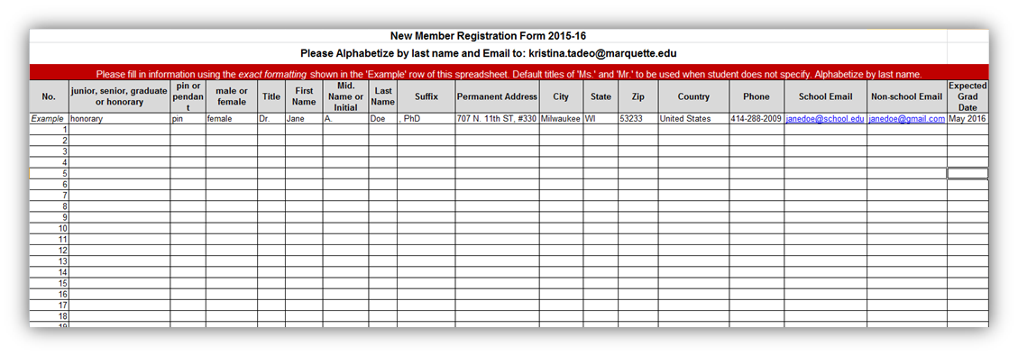
New Member Registration Spreadsheet
Complete using the EXACT same formatting as the Example row – including upper case vs lower case, use of periods, commas in suffix, title, etc., and telephone format
NEW!! Include School ID in last column. Have students fill in on app or get IDs from the Registrar
Include non-school email. Titles are required. Default to Mr. and Ms. if none are otherwise provided
Expected Grad Date column - Month/Year format
Use only junior, senior, graduate, or honorary – all inductees must fall into one of these
categories
Include all honorary inductees on the spreadsheet
Alphabetize by last name before sending via email

Slide 16
Induction Order Form
Scan and send the signed form by the 6-week deadline
Be sure to use the latest version of the form
Mail the hardcopy, along with the check, to arrive before the induction date
Percentages help keep the numbers in line with our bylaws – Max 4% enrollment of each of the junior and senior classes; Max 4% enrollment of each graduate dept/program
Take advantage of our program covers + table tents –they’re free!
Central Office will send newsletters, brochures, and pledge cards for each new inductee automatically

Slide 17
Honorary Member Form
Scan and email the signed form by the 6-week deadline
You can have up to FIVE honoraries per year – contact the Central Office for ideas
Include honoraries on the New Member Registration Spreadsheet and in the counts on the Induction Order Form!
A short, paragraph-length explanation of their qualifications is sufficient
New presidents, provosts, chief mission officers, and faculty advisers should be inducted at the first induction after hiring – free of charge and do not count against your five nominations!

Slide 18
END-OF-YEAR REPORTS

Slide 19
Faculty Adviser Annual Report
Survey Monkey – online form https://www.surveymonkey.com/r/FacultyAdviserReport
Link found on our Advisers + Coordinators page
Must be completed by the Faculty Adviser
Submit online as soon as possible after your last event of the academic year.
IMPORTANT for our organization records!
Bylaws
Records
Newsletter, website, etc.

Slide 20
Upcoming Leadership Report
Survey Monkey - online form
Submit as soon as possible after your Chapter board elections
IMPORTANT for our organization records and inclusion on new President conference calls!
Cell phone AND email are a must as our Student Board members meet with the new officers monthly via web conference and connect via email
Regional Leadership Summits + Triennial Conferences take place at start of school year. Need contact information to communicate with students during summer months.

Slide 21
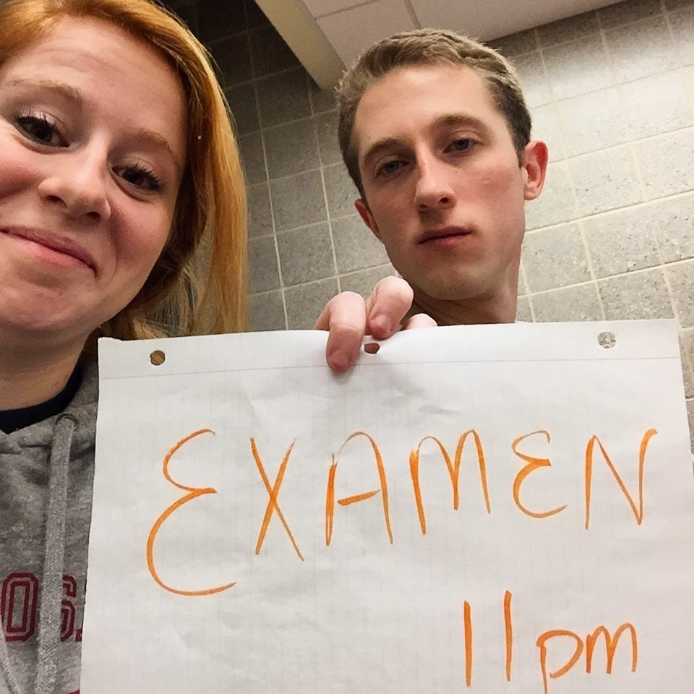
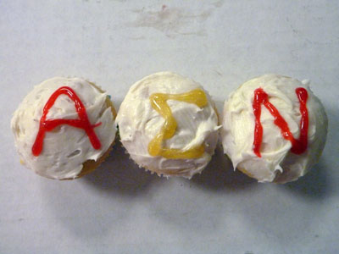
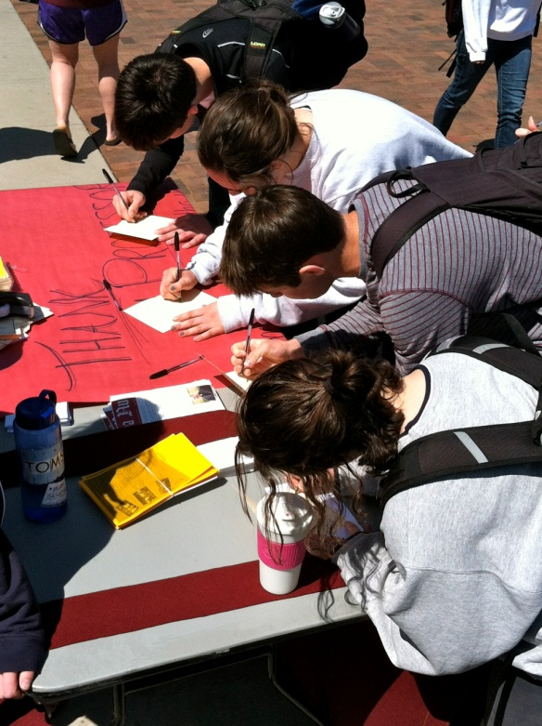
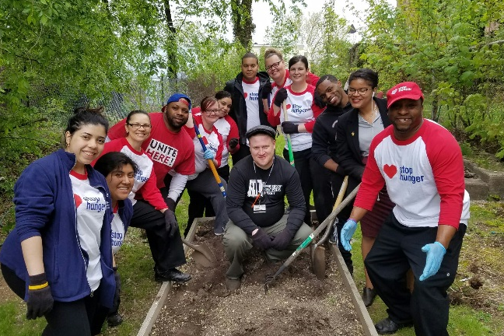
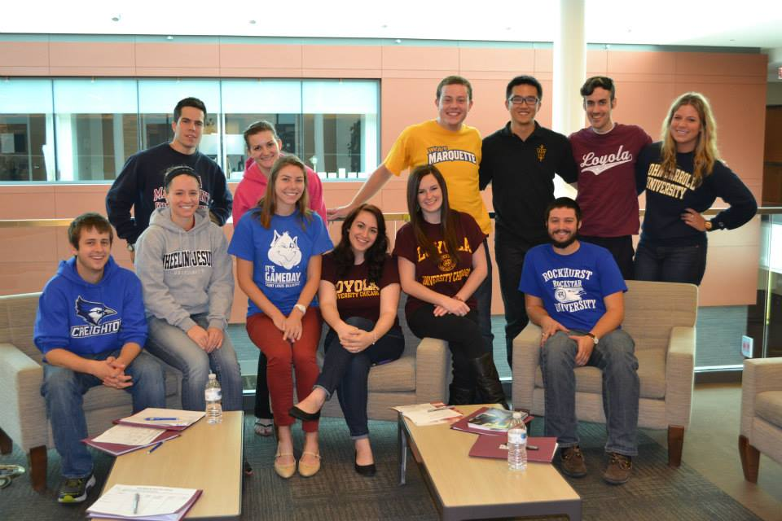
CHAPTER PROGRAMMING

Slide 22
Events/Meetings
Regional Leadership Summits
Brainstorming session for student leaders
Students lead programming – your job is to support/guide them as needed
Get in touch with your student leaders NOW to build that relationship
Nudge them on scheduling an early member meeting
Advisers + Coordinators do not need to attend ALL Chapter events
Student leaders should run events
Helpful if you are there
Advisers MUST attend the Induction Ceremony!!

Slide 23
Alpha Sigma Nu Week
Shared international week of action/marketing around AΣN
Came out of desire on part of Chapters to have a coalescing event
To be held in the spring – each school chooses a week that fits their academic calendars best
Start planning early!
Good to incorporate your induction ceremony into the front end or back end of your AΣN Week
Piggyback on existing campus-wide mission events
Ie. Le Moyne collaborates with their Mission Office on Ignatian Heritage Week and includes AΣN’s name and manpower

Slide 24
TRANSITIONING OFFICERS
Very important role of the Adviser and Coordinator!
See the Best Practices: Transition Time document
Ensure a healthy transition is taking place!
Know the process and have access to all documents and materials the student leaders will be transferring
Communicate with leaders to ensure a meeting is on their calendar

Slide 25
Questions?
Call or email anytime!
Kristina.tadeo@Marquette.edu
Kate.Gaertner@Marquette.edu
Amy.oneil@Marquette.edu

